Slide 1

OSFF London 2025
Unleashing the Power of CDM:
Bridging Integration and Model-Driven Design
Nicholas Moger
JP Morgan
Regulatory Product Director

Slide 2
Agenda
Presentation Goals Slide 3
CDM Adoption Paths Slides 4-8
CDM Development – 30 Minute Challenge Slide 9
CDM Data Ingestion Options Slide 10
CDM Data Ingestion – The Integrator Option Slides 11-12
CDM Data Ingestion – The Model Driven Option Slides 13-14
Regulatory Workflow Handling Options Slide 15
Regulatory Workflow handling – The Integrator Option Slide 15
Regulatory Workflow handling – The Model Driven Option Slide 16
Other Opportunities Slides 17-21
Usage of Domain Specific Languages Slide 22
DSL vs Domain Model Slide 23
Interoperability Slides 24-25
CDM/DRR Development Environments Slide 26
Wrap-Up Slide 27

Slide 3
Presentation Goals
As a Product Director I am not formally responsible for development/coding
However, I have spent the last 2-3 months experimenting with CDM from a developer standpoint, hoping it will allow me to better articulate a vision for our future state SDLC.
I will share that experience today with the following goals in mind:
Push you (gently) off the fence on your CDM implementation decision
Help current or future implementers shape or enhance their SDLC
Navigate the setup/transformation of your SDLC for leveraging CDM/DRR and beyond
Help bridge the communication gap between Product Managers and Developers on your implementation vision
But first – I will explain the wordy title!
Notes:
I usually start these types presentations with an overview of what CDM is, and I use DRR as an example Use Case. I’m conscious you are all going to be sat through a lot of technical presentations today so I wanted to mix things up a bit with the opener.
You may start to think you have walked in on the wrong presentation, but I promise I will bring this back to CDM.

Slide 4
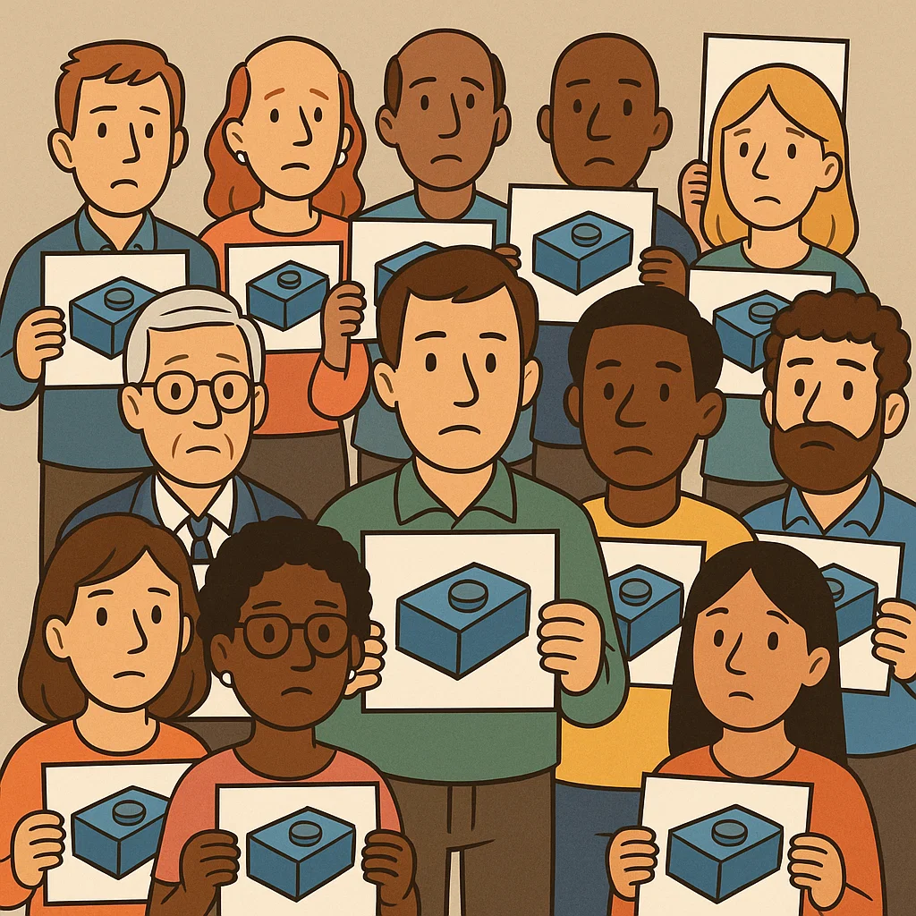
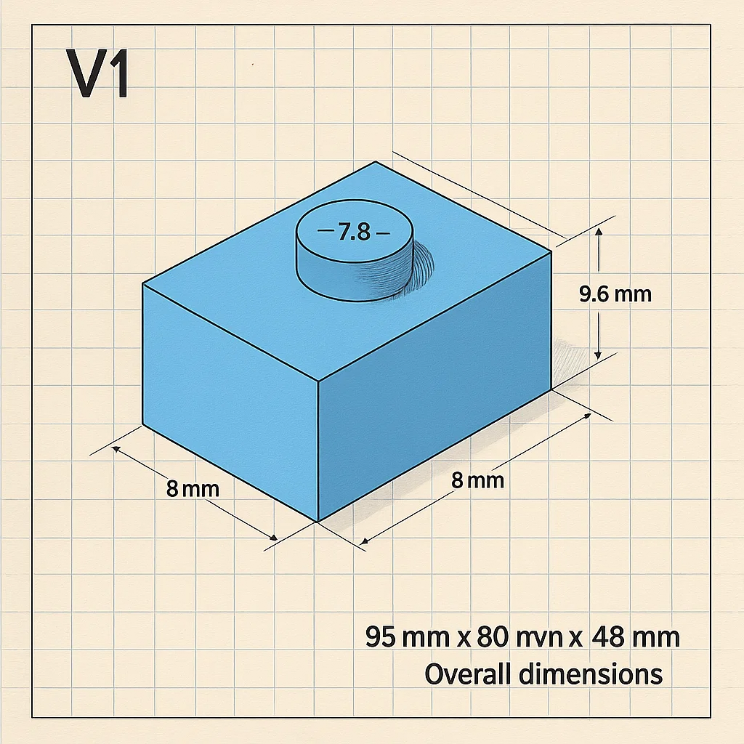
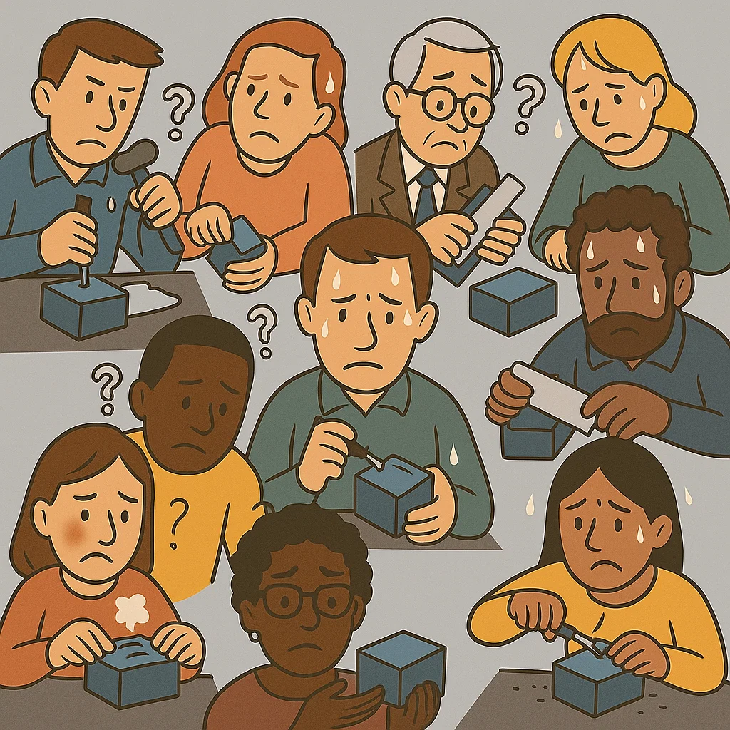
CDM Adoption Paths
A group of people have a shared problem
They all need to build a ‘widget’ to perform a specified function.
They have a set amount of time and there are going to be judged on the quality of the output.
They all have basic paper instructions on how to build the widget by hand.
Everyone gets to work, building their widgets individually using the tools available to them.
The pressure is on to meet the deadline and pass the quality inspection!

Slide 5
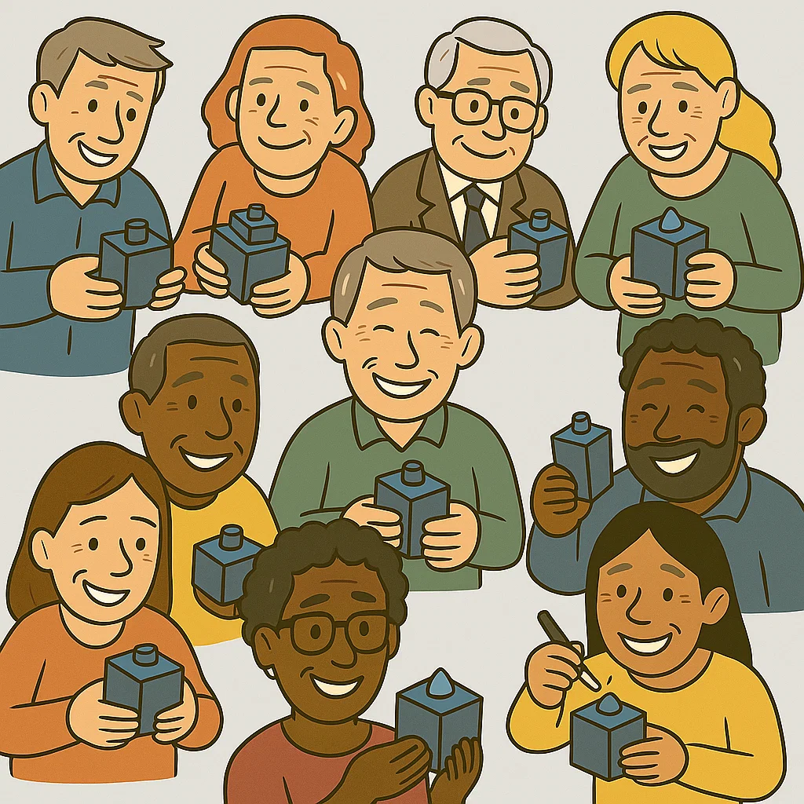
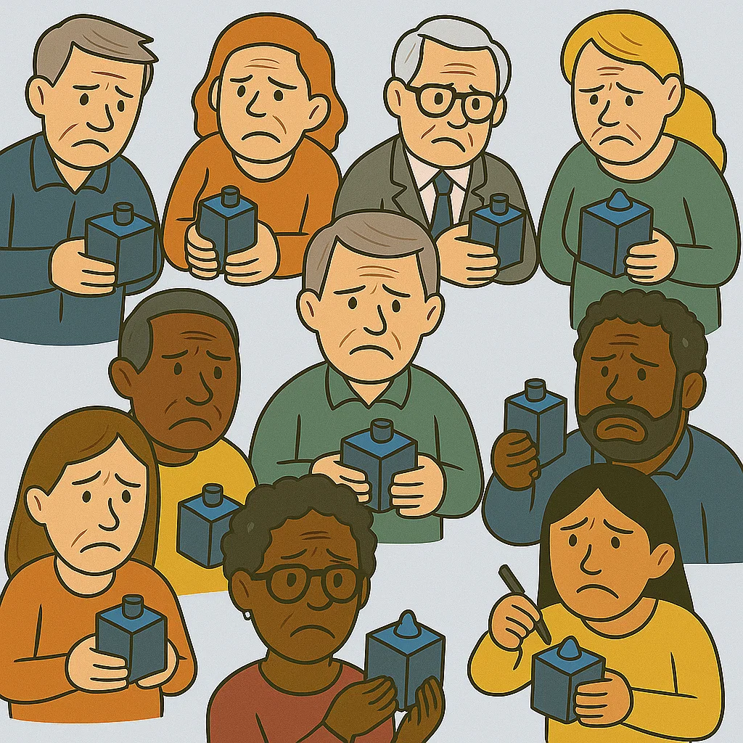

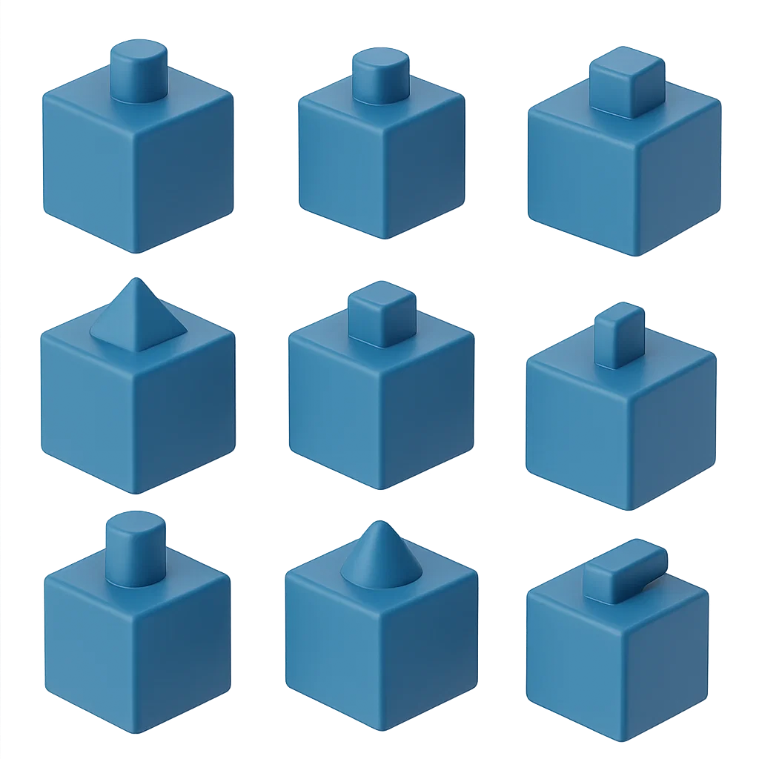
CDM Adoption Paths
Expected Result
Results
People start to realise their widgets don’t perform consistently against the specification.
The group have more work to do.
The deadline arrives and (almost) everyone has completed their widget on time.
Let's see how they did…

Slide 6
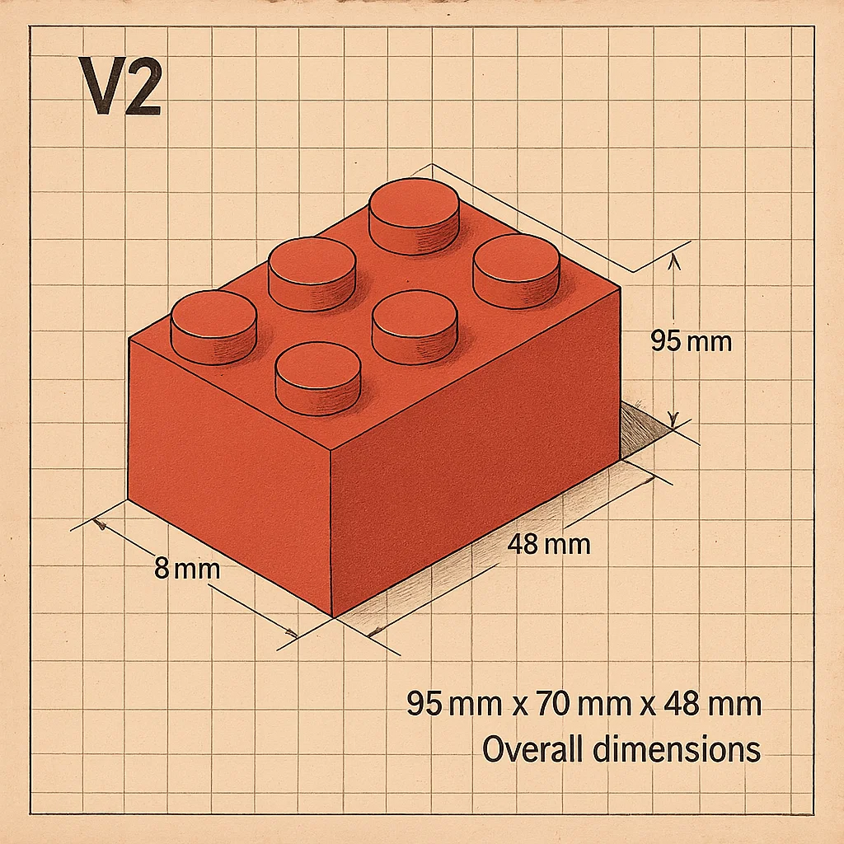

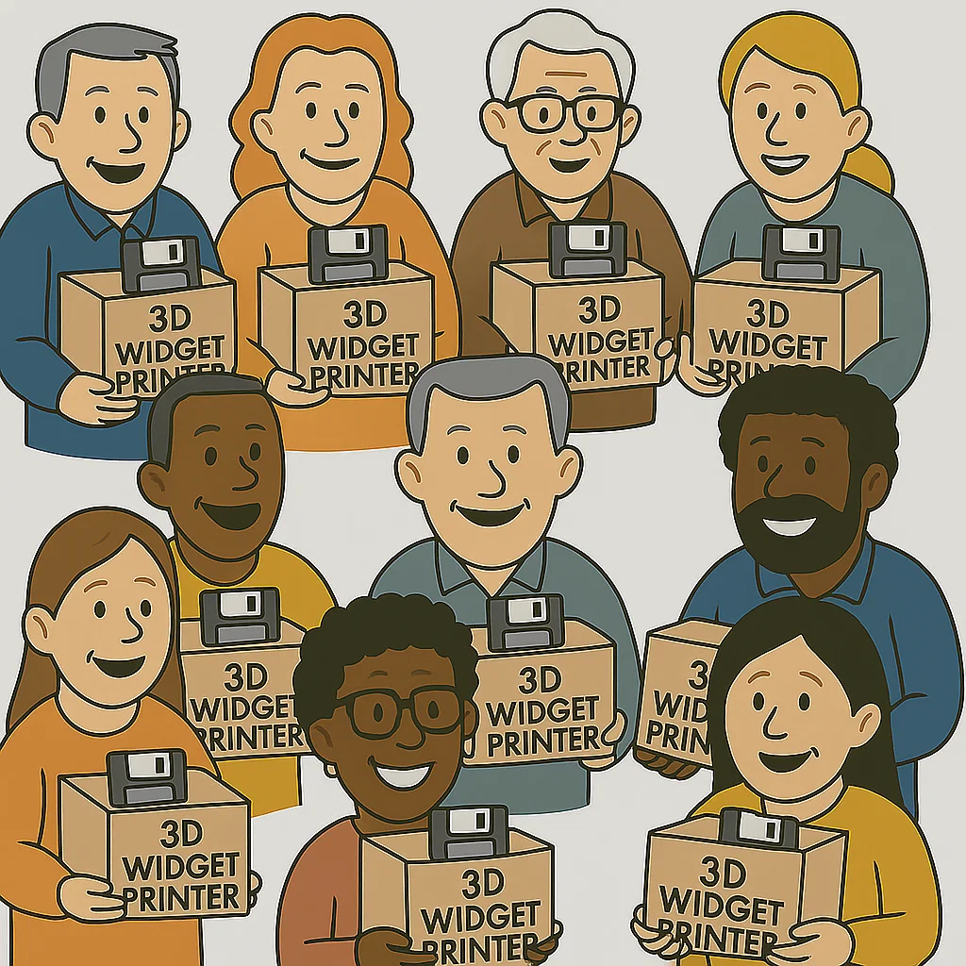
CDM Adoption Paths
A few years later…
Everyone must build a new widget from scratch
The V1 widget build was a horrible experience.
So why is everyone so happy…?
Because this time around everyone is given a free 3D printer and digital copies of the widget plans!
Notes:
I usually start these types presentations with an overview of what CDM is, and I use DRR as an example Use Case. I’m conscious you are all going to be sat through a lot of technical presentations today so I wanted to mix things up a bit with the opener.
You may start to think you have walked in on the wrong presentation, but I promise I will bring this back to CDM.

Slide 7
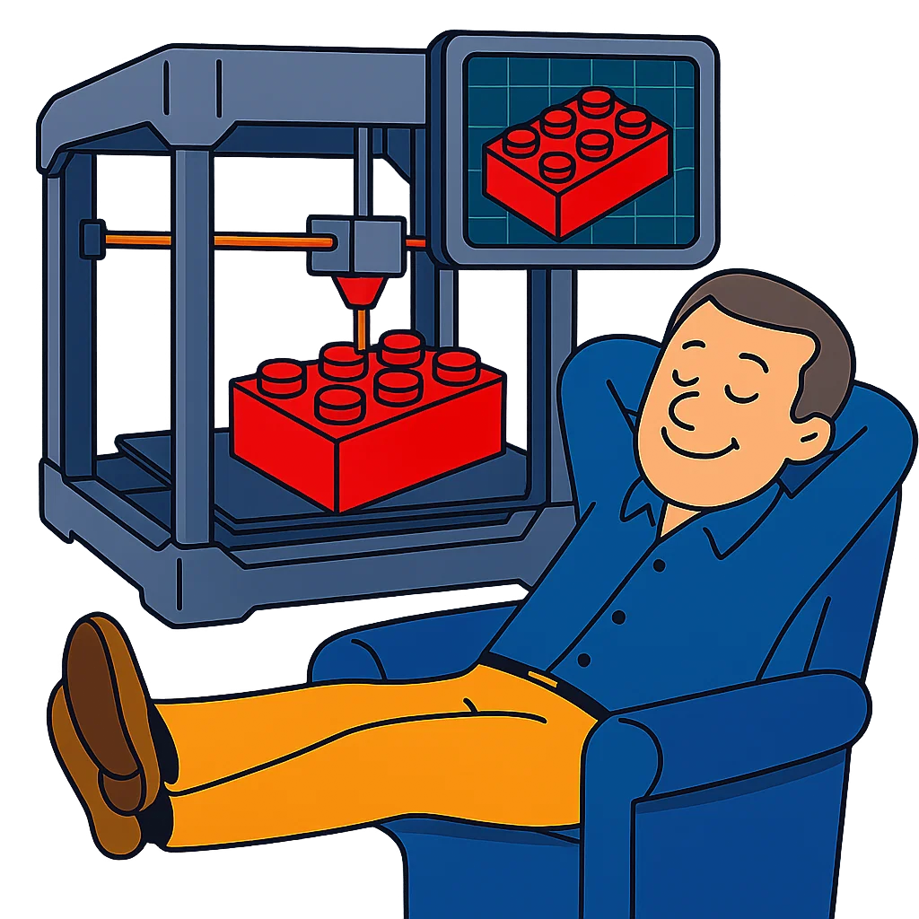
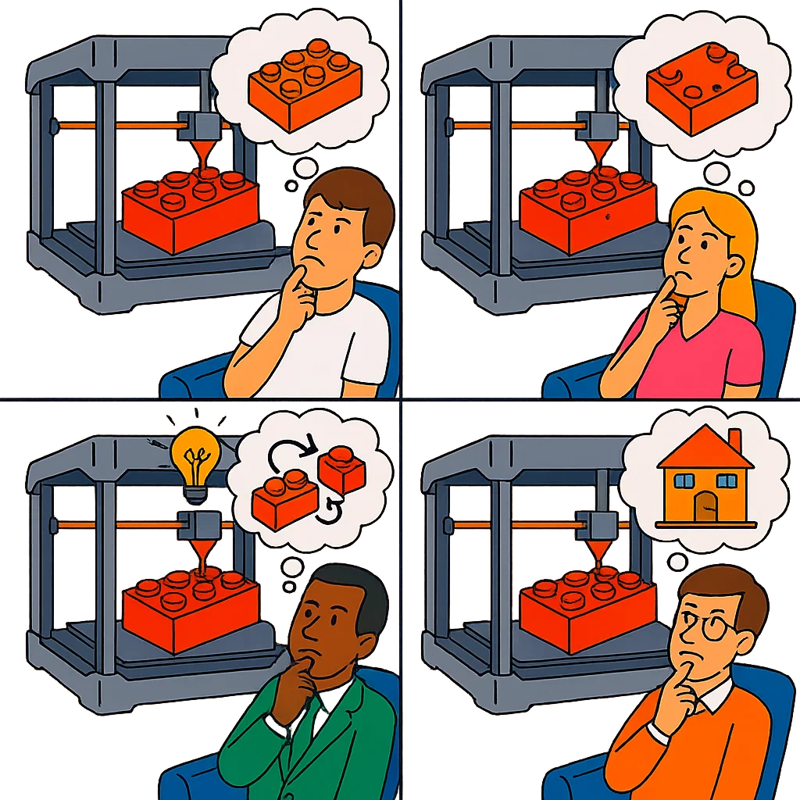
CDM Adoption Paths
This is a game changer!
No more manual widget building
Guaranteed consistent output
Life is good!
But with all the spare time these people now have, they start to wonder:
What else can I produce with this 3D printer?
What enhancements can I make to the printer?
Notes:
I usually start these types presentations with an overview of what CDM is, and I use DRR as an example Use Case. I’m conscious you are all going to be sat through a lot of technical presentations today so I wanted to mix things up a bit with the opener.
You may start to think you have walked in on the wrong presentation, but I promise I will bring this back to CDM.

Slide 8

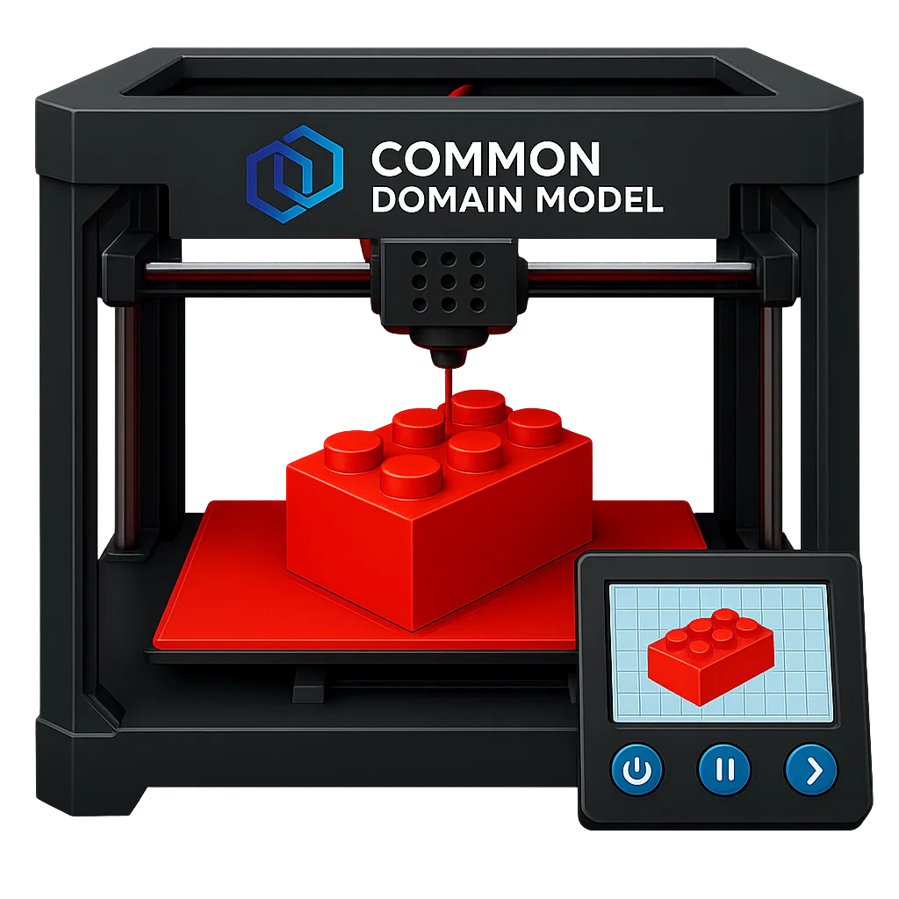
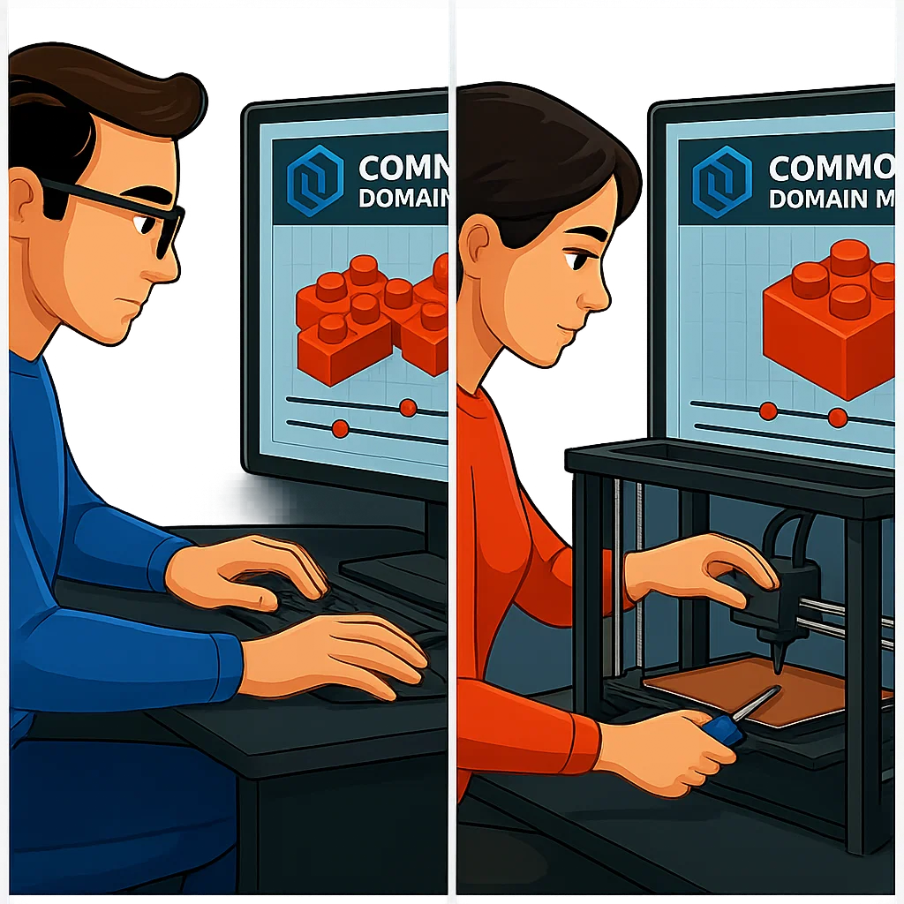
CDM Adoption Paths
Wordy Title
As a CDM Integrator you can freely:
Use the printer for free
Leverage pre-existing designs for free
However, embracing Model Driven Design/Development will empower you to:
Enhance the printer
Update Existing designs
Create your own designs
Notes:
I usually start these types presentations with an overview of what CDM is, and I use DRR as an example Use Case. I’m conscious you are all going to be sat through a lot of technical presentations today so I wanted to mix things up a bit with the opener.
You may start to think you have walked in on the wrong presentation, but I promise I will bring this back to CDM.

Slide 9

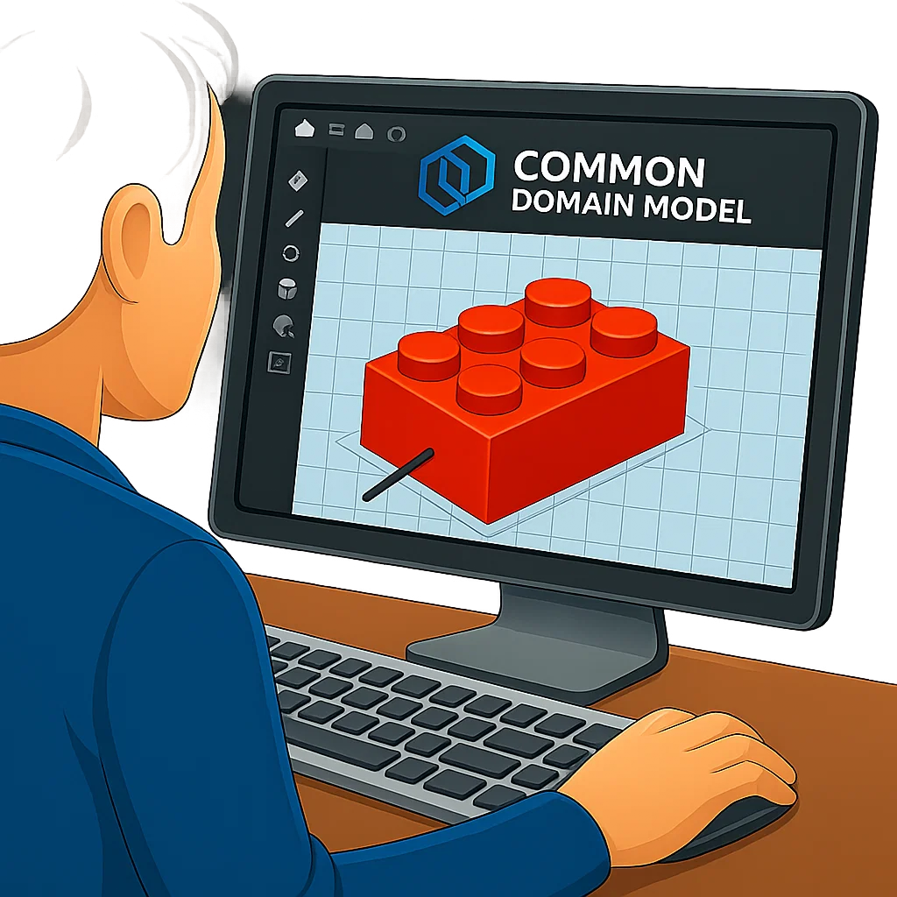

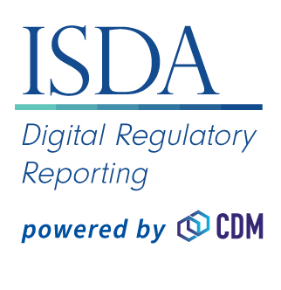
CDM/DRR Development – 30 Minute Challenge
.git
DRR Github
Clone Repo
.Rosetta
Rune Source Files
Code Generation
Generated Java
Java Classes
Code Packaging
Prior to April 2025 I had never personally created a CDM/DRR build
I wanted to experience the build process as a casual developer
The challenge I set myself:
Setup a developer environment
Install Prerequisites
Clone CDM Repo
Do the build
Execute something in DRR
Document the process for other casual/non developers
Packaged JAR
Java Package
Code Execution
Java Runtime
Visit https://github.com/nicholas-moger/CDM-Resources/tree/main/GetStartedNow
CDM Object
DRR Object
Code Outputs
Guide to getting up and running in under 30 minutes
Cheat Sheets and Explanations aimed at casual/non developers
JSON Projection
JSON/XML Projections
Projections
Notes:
Things have moved on a bit since I did my Sun Certified Java Developer Course in 2006
I have a pet hate for the proliferation of README.md -

Slide 10

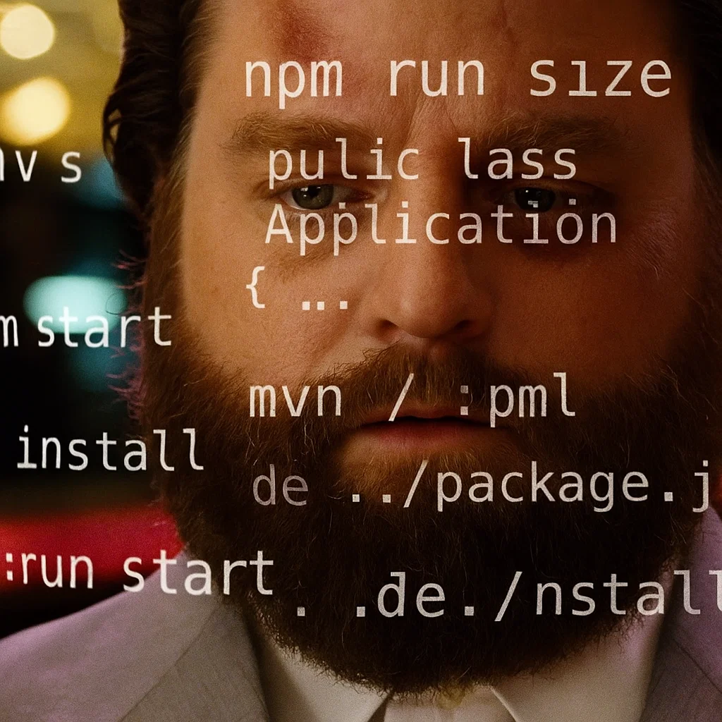
CDM Data Ingestion Options
.git
Under 30 minutes
Clone Repo
Install Pre-Requisites
Run Local Build
Execute Something
.Rosetta
Rune Source Files
Code Generation
Generated Java
What's Next?
Get your own data into CDM
You have some choices here:
Custom data extractor coupled with CDM Creation Java Functions
Leverage Rune directly to model your internal data and ingestion
For a Java developer who wants to make progress quickly, the path of least resistance will be option 1, and this is the CDM integrator go-to solution.
Let's examine this solution…
Java Classes
Code Packaging
Packaged JAR
Java Package
Code Execution
Java Runtime
CDM Object
DRR Object
Code Outputs
JSON Projection
JSON/XML Projections
Projections

Slide 11
CDM Data Ingestion – The Integrator Option
.git
Option 1 - Custom Extraction (CDM Integrator)
You need to get your data into the CDM functions at Java Runtime
Clone Repo
.Rosetta
Rune Source Files
Data
CDM Functions
Code Generation
Generated Java
Java Classes
The solution will vary depending on your architecture, but boils down to:
Code Packaging
Integration Point
Source Data
Packaged JAR
Your Jar
Java Package
Extractor
Code Execution
Custom Java
CDM Functions
Business Logic
Staging Data
Java Runtime
CDM Object
DRR Object
Code Outputs
What is the impact of this implementation choice?
JSON Projection
JSON/XML Projections
Projections

Slide 12
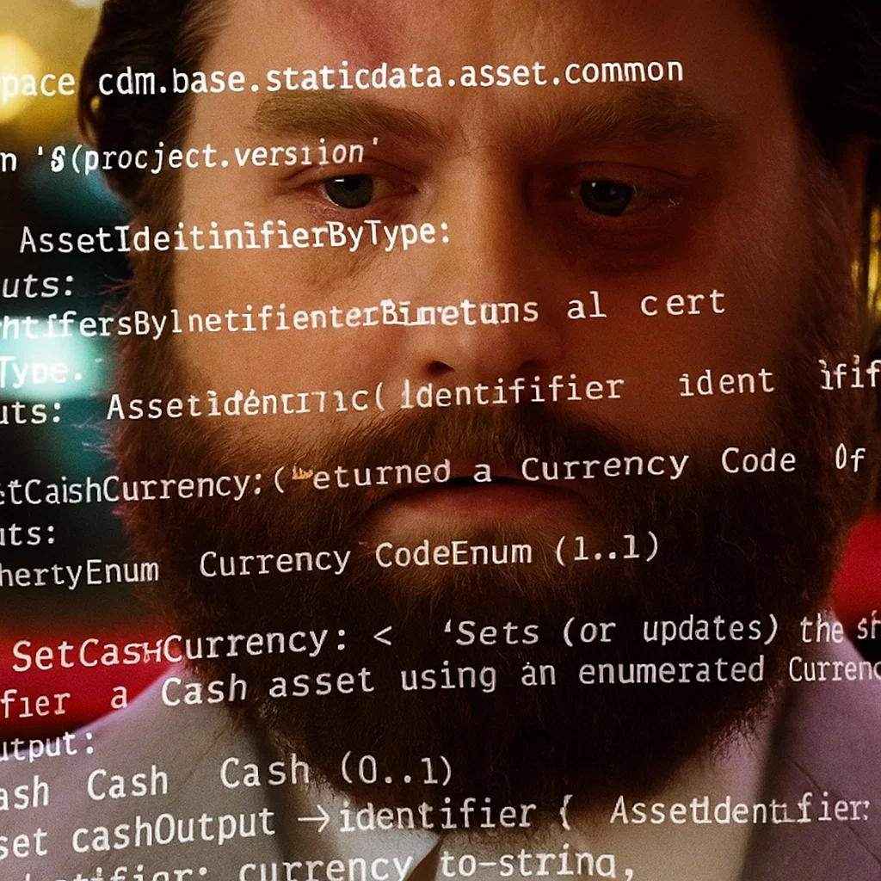
CDM Data Ingestion – The Integrator Option
.git
Impacts:
Java-level dependency
No Rune-Based lineage of CDM back to your source data
For regulatory implementations you may be required to maintain this mapping from source to CDM
You may have complex business logic within the extraction
You will likely maintain an intermediary model for Java Staging
You need to integrate your build process with the CDM/DRR build process
This is by no means the wrong approach. In fact, it will likely be the fastest route to a POC or Demo for a Java developer.
You are not missing out on any CDM functionality with this approach.
Clone Repo
.Rosetta
Rune Source Files
Code Generation
Generated Java
Java Classes
Code Packaging
Integration Point
Packaged JAR
Your Jar
Code Execution
Java Runtime
But there is a better way…
CDM Object
DRR Object
Code Outputs
JSON Projection
JSON/XML Projections
Projections

Slide 13
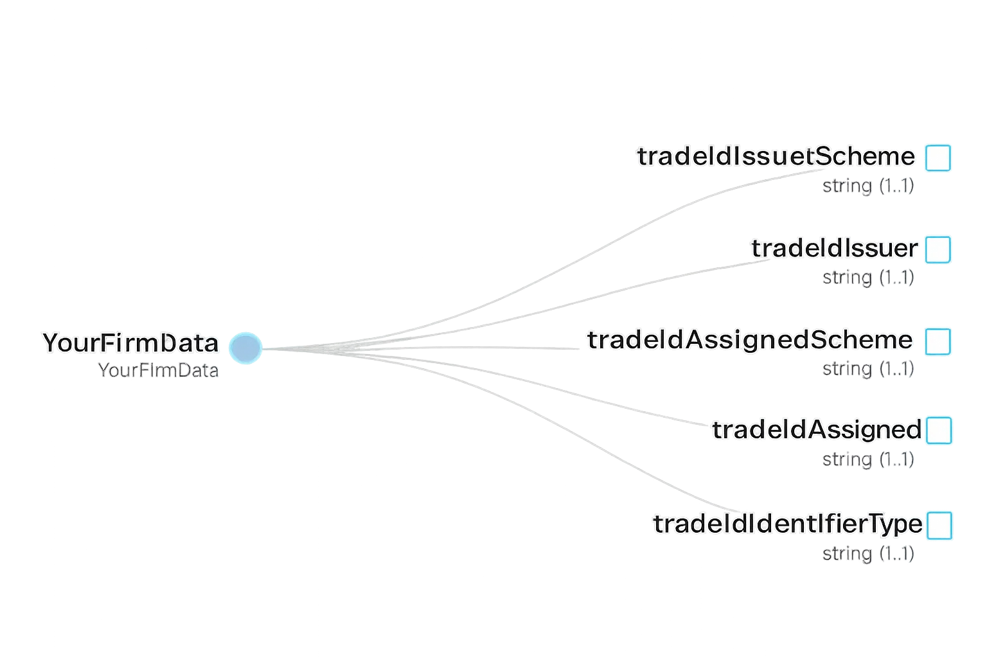
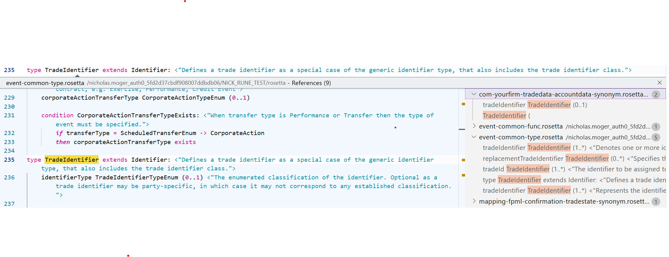
CDM Data Ingestion – The Model Driven Option
Option 2 – Direct Rune DSL Integration (Model Driven Development)
Step 1 - Model your data in Rune (Type/Enum/Func/Synonym/Ingest)
namespace yourfirm.model
type YourFirmData:
[rootType]
tradeIdIssuerScheme string(pattern: "\\w+:(\\/?\\/?)[^\\s]+") (1..1)
tradeIdIssuer string (1..1)
tradeIdAssignedScheme string(pattern: "\\w+:(\\/?\\/?)[^\\s]+") (1..1)
tradeIdAssigned string (1..1)
tradeIdIdentifierType string (1..1)
Your Type
CDM Type

Slide 14
CDM Data Ingestion – The Model Driven Option
.git
DRR Github
Impacts:
Rosetta (Rune DSL) Level Dependency
All Java Code for Ingestion can be generated
Business Logic can be exposed in one place (Rosetta UI)
Mastered model can be annotated extensively and versioned
Data can be ingested in source format without intermediary model
If using Rosetta UI you can integrate ingestion test packs for a full E2E experience
Unified Build Process
Once the ingest process is understood, and you have a good understanding of Rosetta/Rune DSL you will find development to be faster in the long term with this approach.
I created a basic project showing how ingestion works with Rune DSL, with sample input files and sample projections using a custom model. Visit the GitHub link below to understand more.
Clone Repo
Integration Point
.Rosetta
Your .Rosetta
Rune Source Files
Code Generation
Generated Java
Java Classes
Code Packaging
Packaged JAR
Java Package
Code Execution
Java Runtime
Visit https://github.com/nicholas-moger/CDM-Resources/tree/main/IngestionSample (vscode project)
CDM Object
DRR Object
Code Outputs
JSON Projection
JSON/XML Projections
Projections

Slide 15
Regulatory Workflow Handling Options
.git
Get Data into CDM
Manage Regulatory User Interface
DRR Github
Clone Repo
Integration Point
.Rosetta
Your .Rosetta
Rune Source Files
What's Next?
When using ISDA Digital Regulatory Reporting you will likely want to display DRR projections and validations in a user interface
Again you have two choices here:
Handling the projections directly (parsing)
Create UI management functionality in Rune DSL
Option 1 - Direct Projection Integration:
You will have to write a parser for multiple formats (JSON/XML)
The data on the projection may not meet your needs for a user interface
You may need to augment data from multiple sources (CDM Object + Projection)
You have also created another Java level dependency (assuming Java implementation)
You will have to store and process/augment the projection
What if the projection format changes?
Code Generation
Generated Java
Java Classes
Code Packaging
Packaged JAR
Java Package
Code Execution
Java Runtime
CDM Object
DRR Object
Code Outputs
Integration Point
JSON Projection
JSON/XML Projections
Your Jar
Projections

Slide 16
Regulatory Workflow Handling Options
.git
Get Data into CDM
Manage Regulatory User Interface
DRR Github
Clone Repo
Integration Point
.Rosetta
Your .Rosetta
Rune Source Files
What's Next?
When using ISDA Digital Regulatory Reporting you will likely want to display DRR projections and validations in a user interface
Again you have two choices here:
Handling the projections directly (parsing)
Create UI functionality in Rune DSL
Option 2 – User Interface Model Driven Development:
Author your UI data model requirements in Rune DSL
Create custom functions to output your UI data exactly as required
Easily combine data from multiple sources
Leverage in-built functions along with your own
Huge SDLC maintenance and documentation advantages longer term
Code Generation
Generated Java
Java Classes
Code Packaging
Packaged JAR
Java Package
Code Execution
Java Runtime
CDM Object
DRR Object
Code Outputs
JSON Projection
JSON/XML Projections
Projections

Slide 17
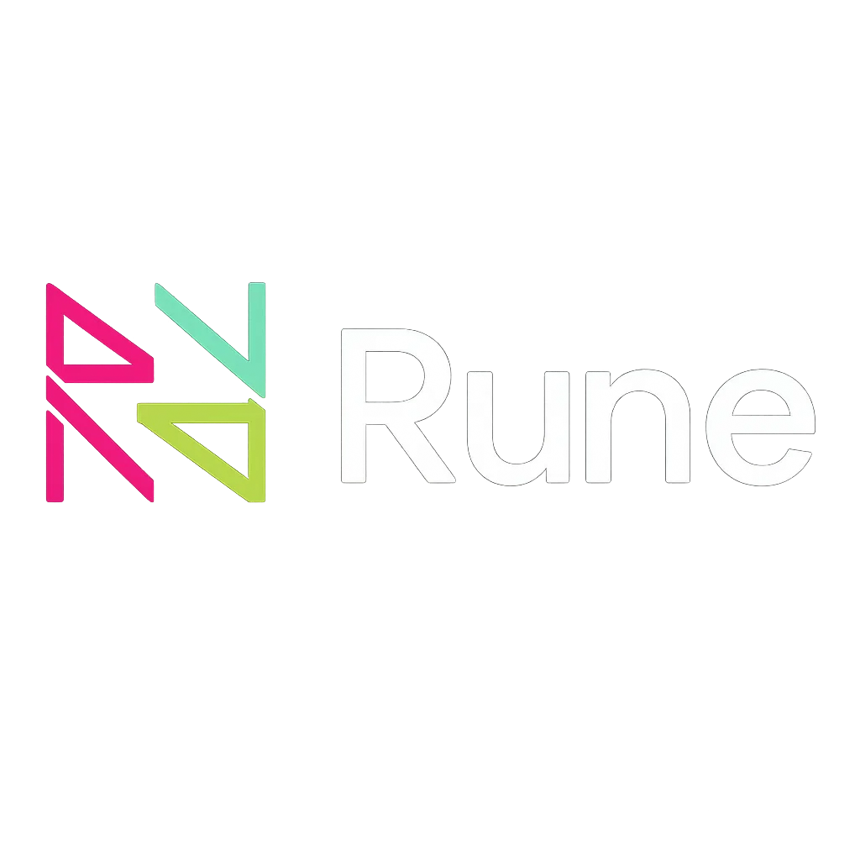

Other Opportunities
Let's bring this together into a realistic E2E flow with CDM/DRR
Source Data
Extractor
Ref Data
External APIs (ISIN/UPI/GLEIF)
Regulatory Ingest
Regulatory Eligibility
UI Projections
Trade Ingest
Trade Translate
Regulatory Translate
Custom Validations
YourFirm Model
CDM for DRR
DRR
Key Features:
YourFirm Model In Rune
Ingest Translate via Rune DSL
CDM for DRR Integration
Ingestion of Ref Data into model
Authored Regulatory Eligibility Logic in Rune
Custom User Interface Projections
Custom Validations (Extending Existing Validations)
Notes:
Let's look at a possible Target State Regulatory Flow

Slide 18
Other Opportunities
Source Data
Extractor
Ref Data
External APIs (ISIN/UPI/GLEIF)
Regulatory Ingest
Regulatory Eligibility
UI Projections
Trade Ingest
Trade Translate
Regulatory Translate
Custom Validations
YourFirm Model
CDM for DRR
DRR
What Next?
YourFirm Model is now Mastered In Rune – What other opportunities does this give?
CDM for DRR – If you intend to leverage CDM for other use cases, you may want to protect this path of CDM creation for regulatory reporting only (to minimise regulatory regression)

Slide 19
Other Opportunities
Source Data
Extractor
Ref Data
External APIs (ISIN/UPI/GLEIF)
Regulatory Ingest
Regulatory Eligibility
UI Projections
Trade Ingest
Trade Translate
Regulatory Translate
Custom Validations
YourFirm Model
CDM for DRR
DRR
Non CDM Reports and Feeds
CDM V6
Opportunities:
Legacy Feed Uplift:
Migrate your custom non-CDM internal feeds and reports to Rune
Enhances existing black box reports with Rune Modelling
Project in legacy formats to ensure no consumer impact
Transform legacy SDLCs and Change Management
Multiple CDM Versions
Project your trade data into alternate CDM versions for non-regulatory development
Protect your critical regulatory workflow from regression risk
Decouple your Critical Regulatory CDM Use Case from other CDM flows
This can be achieved in multiple ways (multi version or conversion)

Slide 20
Other Opportunities
Source Data
Extractor
Ref Data
External APIs (ISIN/UPI/GLEIF)
Regulatory Ingest
Regulatory Eligibility
UI Projections
Trade Ingest
Trade Translate
Regulatory Translate
Custom Validations
YourFirm Model
CDM for DRR
DRR
Non CDM Reports and Feeds
Custom CDM Extensions
YourFirm Model 2
CDM V6
Non Reg CDM Use Cases
Opportunities:
Legacy Feed Uplift:
Migrate your custom non-CDM internal feeds and reports to Rune
Enhances existing black box reports with Rune Modelling
Project in legacy formats to ensure no consumer impact
Transform legacy SDLCs and Change Management
Multiple CDM Versions
Project your trade data into alternate CDM versions for non-regulatory development
Protect your critical regulatory workflow from regression risk
Decouple your Critical Regulatory CDM Use Case from other CDM flows
This can be achieved in multiple ways (multi version or conversion)
Multi Model Support:
Often firms will have multiple internal models
Create model to model conversion in Rune or master multiple ingestion models
Reduce drawbacks/overhead of multi-model management
Extending CDM:
CDM may not have classes you need
Extend CDM internally to carry bespoke or proprietary data
Optionally contribute back to industry master
Alternate CDM Use Cases:
Implement one of the many (and growing) alternate CDM Use Cases

Slide 21
Other Opportunities
Transform Trade Management Checks:
Do you have APIs in your workflow such as pre-trade checks and eligibility checks?
Is there an API consumer burden when new checks are added?
Implement CDM Based APIs:
Send CDM instead of custom API calls
Reduce overhead on API consumers for adding additional checks
Receive augmented CDM in return
Source Data
Extractor
CDM-Based Checks
Ref Data
External APIs (ISIN/UPI/GLEIF)
Regulatory Ingest
Regulatory Eligibility
UI Projections
Risk/Trade Management
Trade Ingest
Trade Translate
Regulatory Translate
Custom Validations
YourFirm Model
CDM for DRR
DRR
Non CDM Reports and Feeds
Custom CDM Extensions
YourFirm Model 2
CDM V6
Non Reg CDM Use Cases

Slide 22
Usage of Domain Specific Languages
At this point as a system architect, you may be thinking:
What are the risks of creating large dependencies on a single DSL?
What if you already leverage existing DSLs?
What if a superior DSL comes along in the future?

Slide 23
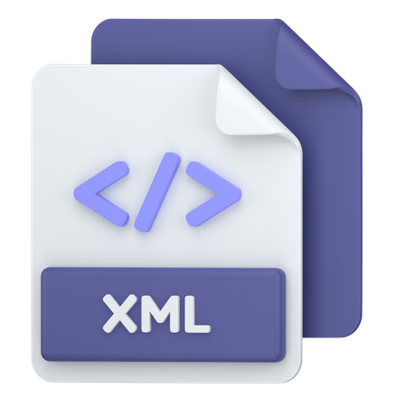
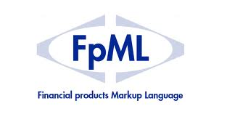
DSL vs Domain Model
DSLs or Domain Specific Languages exist to allow for the creation of Domain Models
CDM is a Domain Model which has a domain of Financial Products
Rune DSL is a special case, because its ‘Domain’ is the ‘Creation of Domain/Meta Models’
You could say Rune-DSL is a Meta-DSL:
Meta-DSL
The ‘Domain’ here is the creation of Domain/Meta Models
DSL Implementation (Domain Model)
The Common Domain Model is an example of a Financial products DSL authored using a Meta-DSL (Rune)
ISDA Digital Regulatory Reporting is a Regulatory Domain Model which extends the Common Domain Model, both authored using a Rune-DSL
Is to
Is to

Slide 24
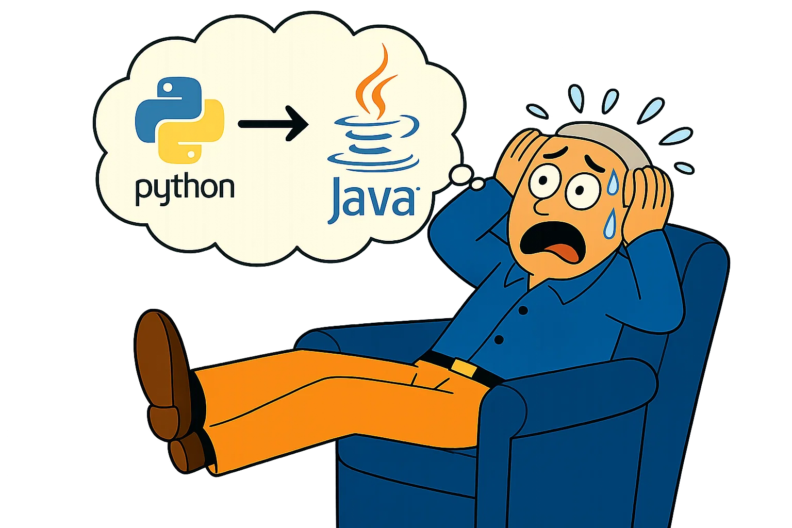
What are the risks of creating large dependencies on a single DSL?
What if you already leverage existing DSLs?
What if a superior DSL comes along in the future?
Imagine you as a developer arrive at work one day – and your CTO says that Python is no longer to be used in your firm, and everything must be transitioned to Java.
Interoperability
Your entire stack is written in Python
Missions of lines of code
Thousands of Python Developers
You would need to change your entire ecosystem:
Runtime behaviour
Hardware integration layers
Typing and Threading differences
Differing memory models
On the face of it an impossible task
Luckily, this is unlikely to ever happen
Now - Lets examine this scenario in the context of the reliance on a single DSL
Remember this guy?

Slide 25

What are the risks of creating large dependencies on a single DSL?
What if you already leverage existing DSLs?
What if a superior DSL comes along in the future?
Interoperability
A Meta-DSL is by nature restrictive in terms of its scope
They exist to define Types/Attributes/Relationships/Enumerations/Inheritance/Constraints
They are declarative, i.e. they describe what exists not what to do, as opposed to having runtime behaviour
Mapping between Meta-DSLs can be automated using AST (Abstract Syntax Tree) and IR (Intermediary Representation)
Let's look at an example using Legend DSL (an alternate DSL which your firm may already use)
While no standard IR exists today between Rune DSL and Legend DSL – creating one would be manageable
An Intermediary Representation is simply JSON describing entities and attributes
Parsers can be created using Python pipelines, or language to language pipelines such as Xtext or ANTLR
While work would be required, in comparison to the compiled language example this is vastly less complex
A firm may wish to have a master Intermediary Representation from which they can parse into one or many Meta-DSLs
type Firm:
name string (1..1)
Rune DSL
{
"nodeType": "Type Declaration",
"name": "Firm",
"fields": [
{
"name": "name",
"type": "string",
"multiplicity": {
"lower": 1,
"upper": 1
}
}
]
}
{
"entity": "Firm",
"attributes": [
{
"name": "name",
"type": "String",
"cardinality": "[1]",
"required": true
}
]
}
Class Firm
{
name: String[1];
}
Neutral Intermediary Representation (IR)
Legend DSL
Abstract Syntax Tree (AST)
Seek out your firm’s Information Architects and find out what is already being done in this space

Slide 26
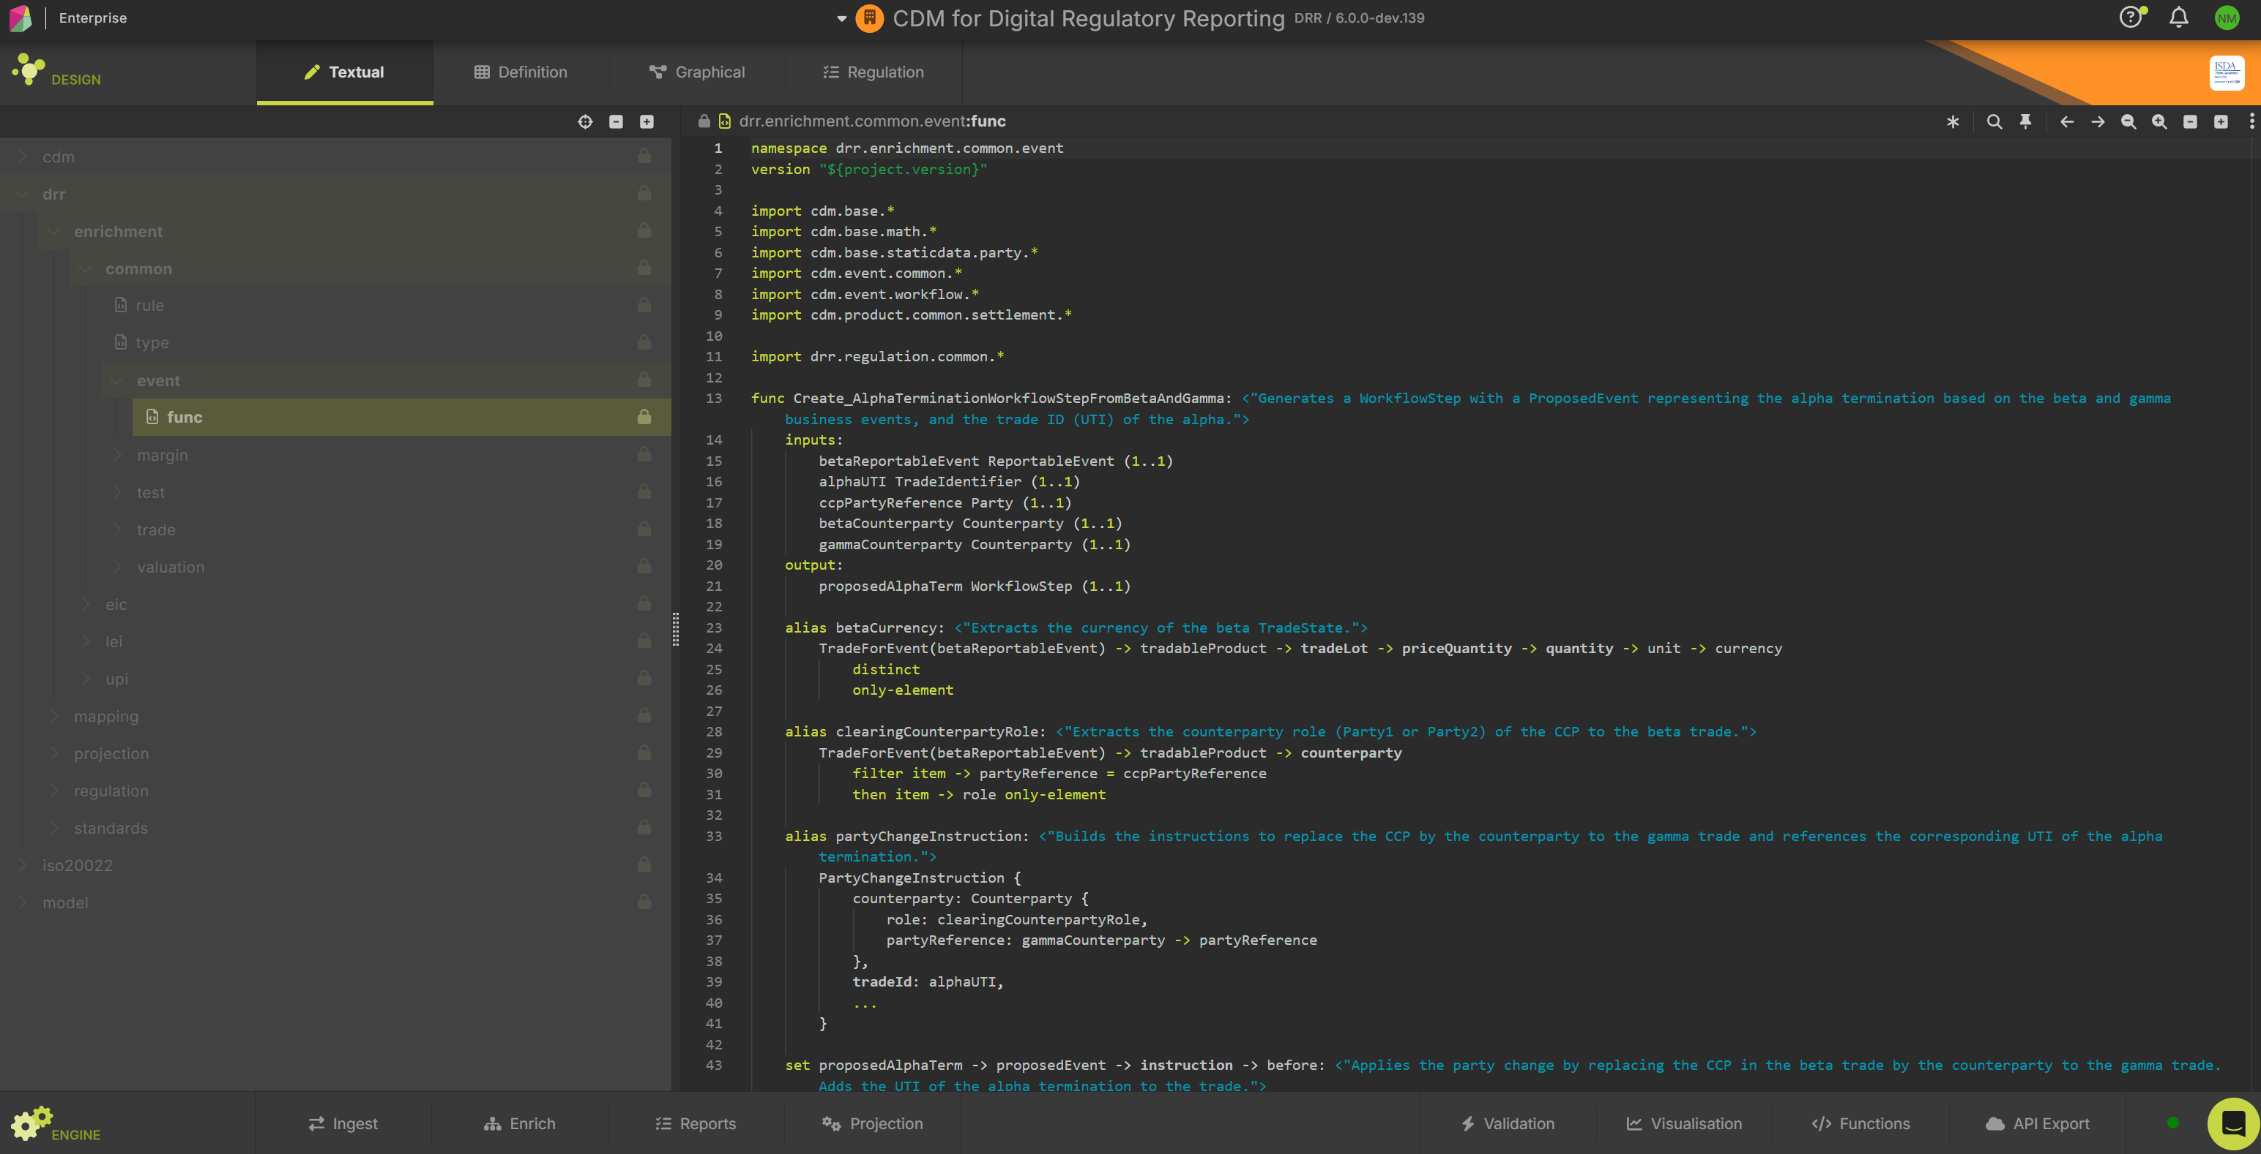
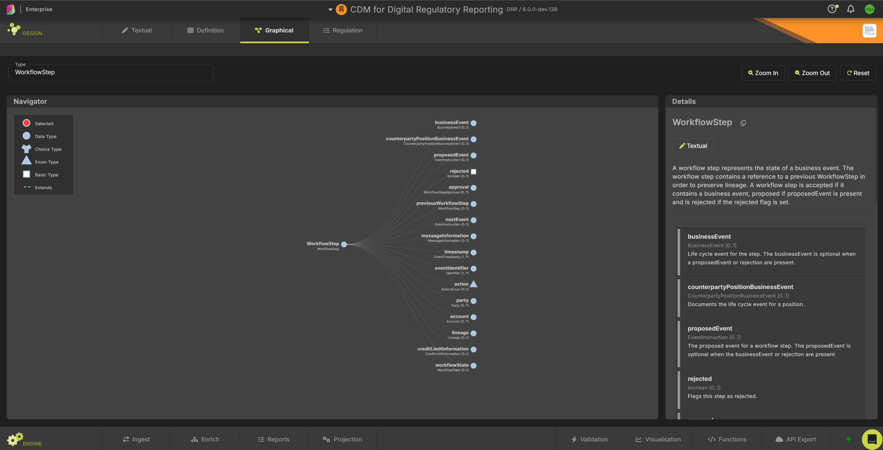
CDM/DRR Development Environments - Rosetta
The Rosetta UI can manage all the features discussed in this presentation (and more)
For us, the stand-out features of a Rosetta license are as follows:
Model Driven Development makes your SDLC accessible to non-developers
The perfect companion for mastering/modelling/cataloguing your data in Rune DSL
Allows you to prototype fixes without requiring a developer to create a build (Rosetta does this dynamically in back-end)
Execute test packs with ease
Interactive use of Ingest functionality
Manage multiple workspaces (builds), models, versions all in one place
And much more
Rosetta is a powerful accompaniment to your future Model Driven SDLC

Slide 27
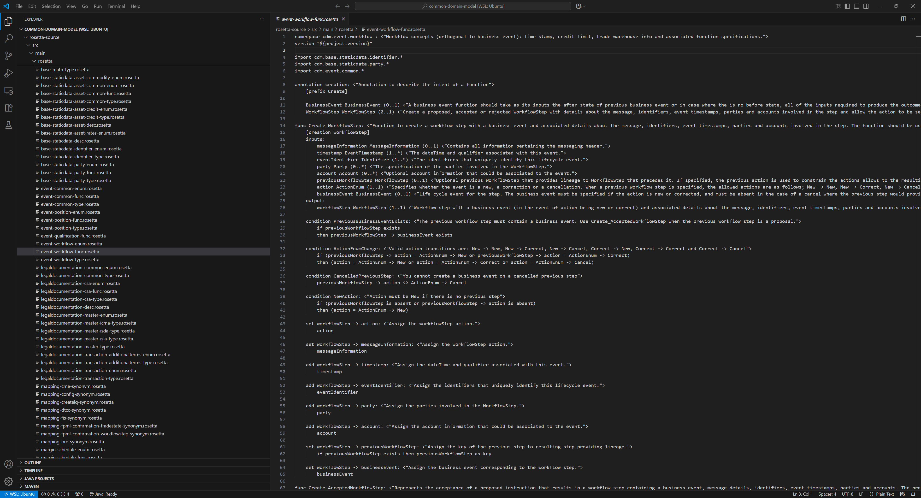
CDM/DRR Development Environments - VSCode

Slide 28
CDM/DRR Development Environments - VSCode
Unfortunately, there is not yet a Language Server plugin for .Rosetta files on Azure Marketplace
However – the Rune-DSL repo does have the basic framework for a plugin ready for the community to extend
I decided to extend/enhance this base plugin with the goal of publishing it for all to use
It still has some teething issues, but a feature complete version will be formally published in due course
For those of you who prefer IntelliJ – we will seek to publish a version which works with LSP4IJ once the VSCode version is complete

Slide 29
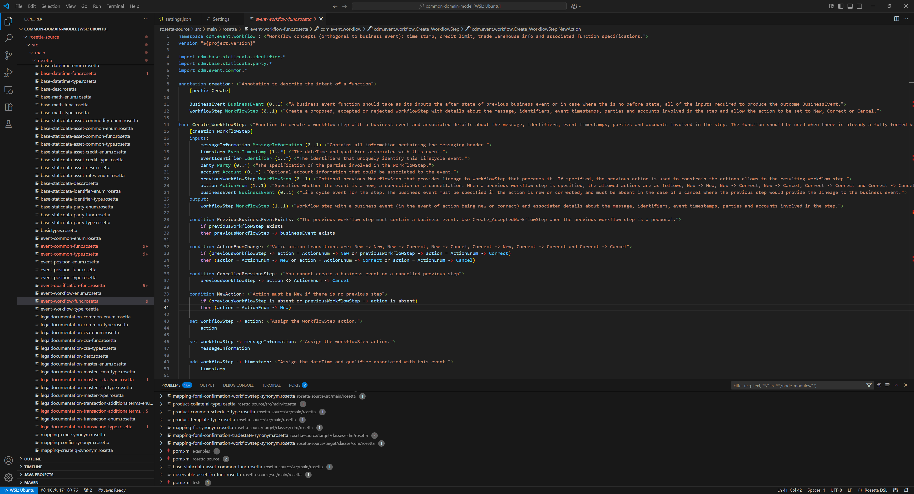
CDM/DRR Development Environments - VSCode
Visit https://github.com/nicholas-moger/CDM-Resources/tree/main/VSCodePlugin (VSIX File)

Slide 30
CDM/DRR Development Environments - VSCode
Visit https://github.com/nicholas-moger/CDM-Resources/tree/main/VSCodePlugin (VSIX File)
What works:
Windows/Mac/Linux Support
Plugin Project builds VSIX from remote sources (all open source)
Plugin Features:
Full Linting/IntelliSense:
Hover
Formatting
Diagnostics
Inlay Hints
Semantic Highlighting
Deprecation Warnings
Java Code Generation (can be enabled in settings, disabled by default)
GitHub Copilot context enhancements
Smart Comments
Integration Hints
Auto copy of basic Types/annotations on startup (from remote)
Adjust JVM memory/startup options for larger projects in settings
Work In Progress:
Code actions (disabled in this version)
Fixes for some false positives in problem detection
Testing, Testing, and more testing
If you have development experience in VSCode/IntelliJ plugins and you wish to contribute, please reach out via GitHub discussions on the link above

Slide 31
Wrap-Up
Thanks for Attending - I hope this has given you some ideas/inspiration about where you want to go next with your Model Driven Development Journey

